Slide 1
Stand on the Shoulder
Introduction to Dynamic Programming (Basics)
Dustin Xu

Slide 2
Seek Treasure in the “Maze”
A Warmup Task for You

Slide 3
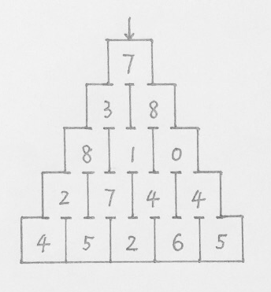
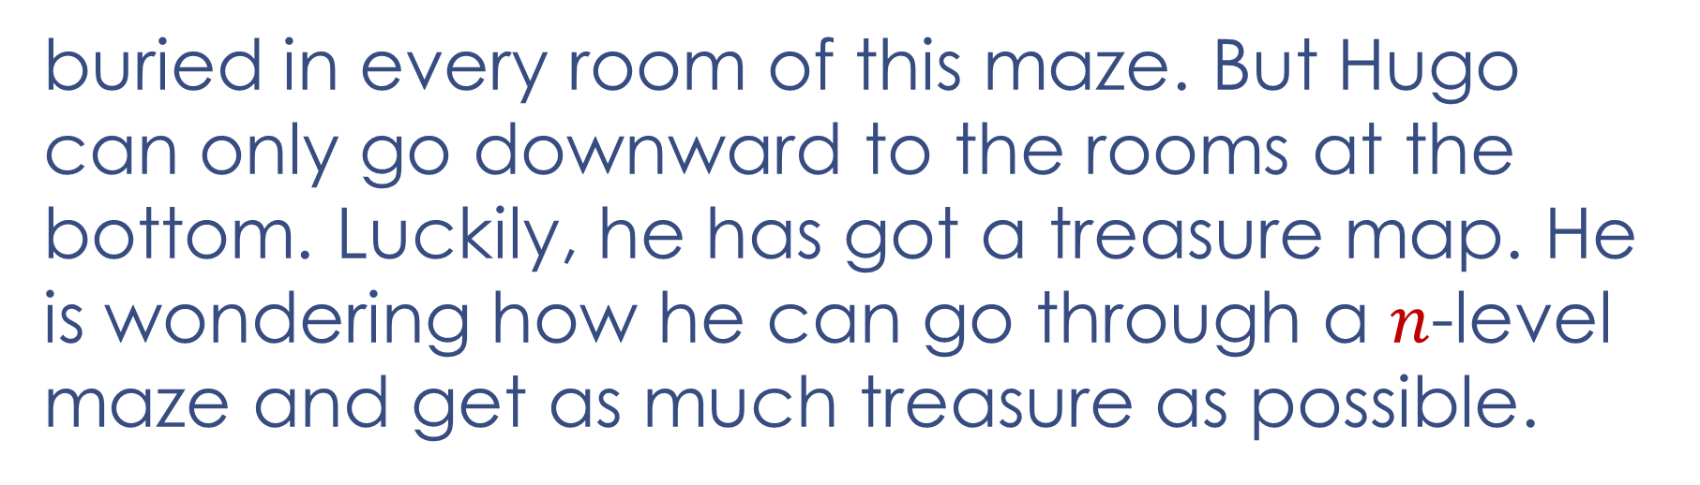
Seek Treasure in the “Maze”
Hugo
Hugo is playing an interesting—actually boring—game called “Maze”. There is some treasure
n=5
buried in every room of this maze. But Hugo can only go downward to the rooms at the bottom. Luckily, he has got a treasure map. He is wondering how he can go through a $n$-level maze and get as much treasure as possible.

Slide 4
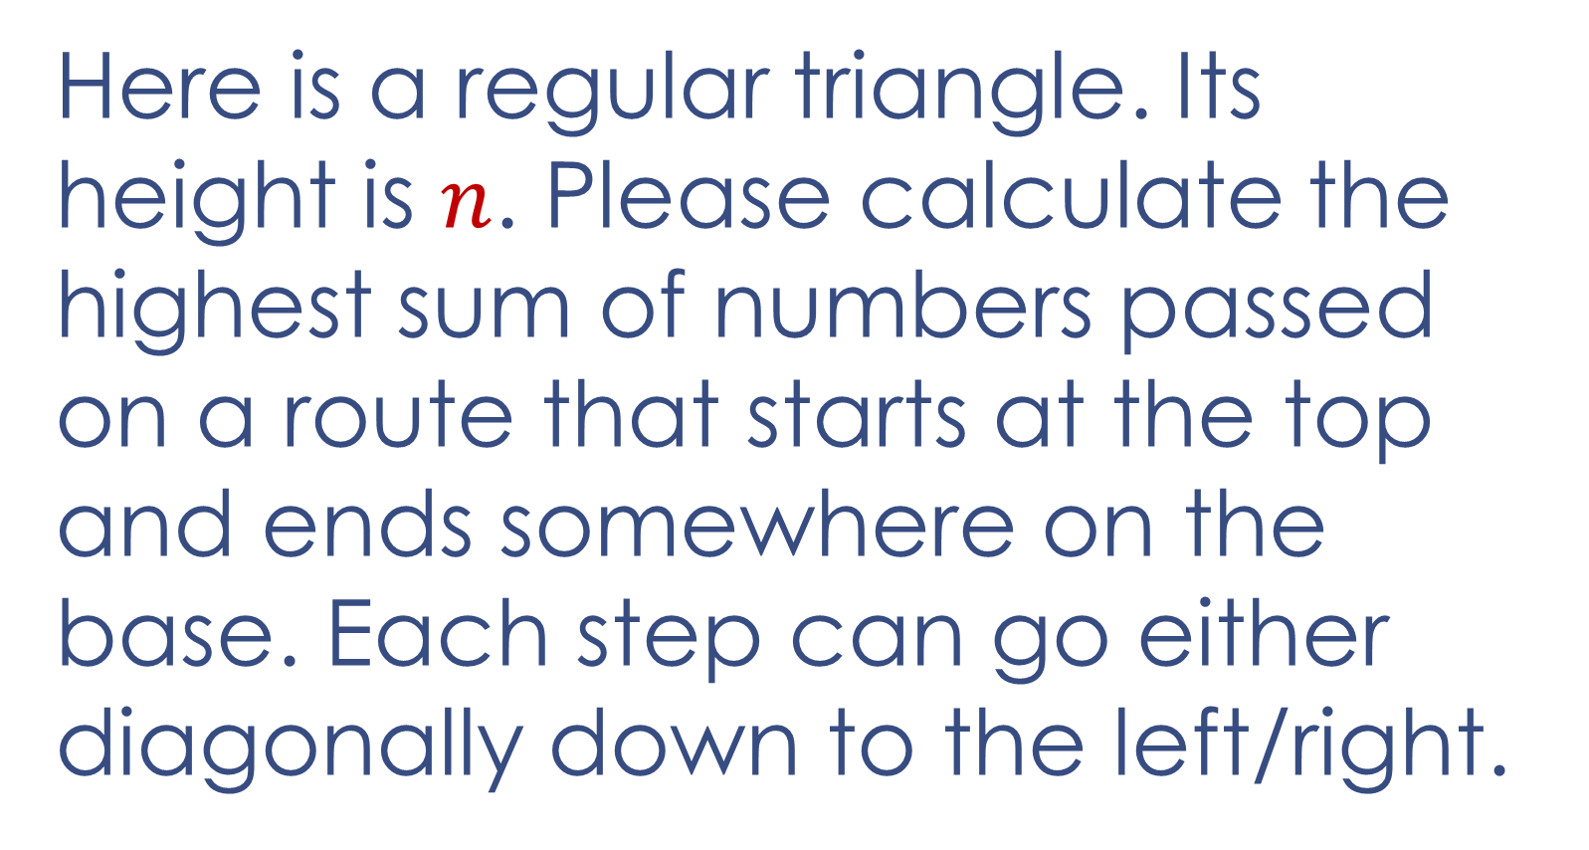
The Triangle
Here is a regular triangle. Its height is $n$. Please calculate the highest sum of numbers passed on a route that starts at the top and ends somewhere on the base. Each step can go either diagonally down to the left/right.
7 3 8 8 1 0 2 7 4 4 4 5 2 6 5

Slide 5
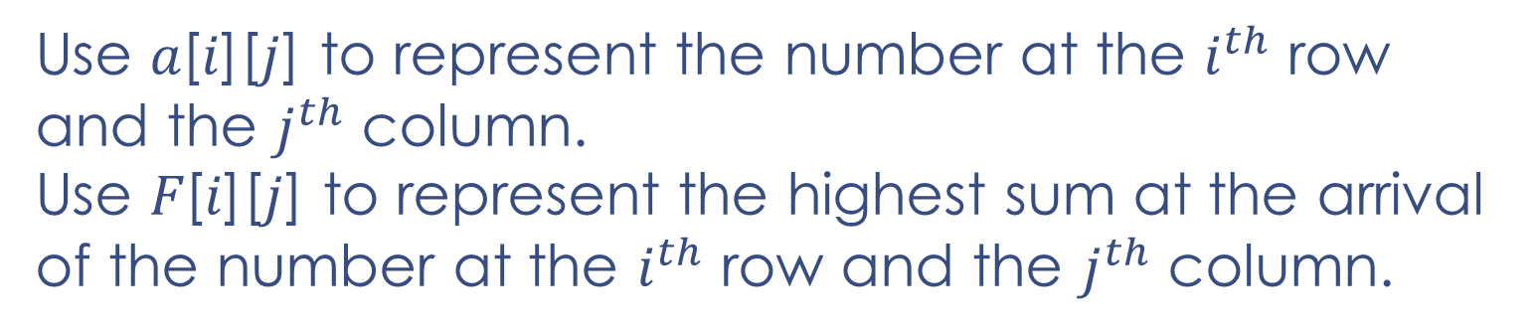
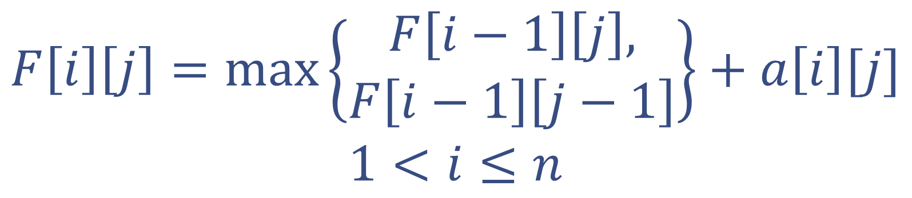


Seek Treasure in the “Maze”
$$j$$
$$1 2 3 4 5$$
$$i=1, 7 \\ i=2, 3 8 \\ i=3, 8 1 0 \\ i=4, 2 7 4 4 \\ i=5, 4 5 2 6 5$$
$$F\left[i\right]\left[j\right]=\max\left\{\begin{aligned}F\left[i−1\right]\left[j\right], \\ F\left[i−1\right]\left[j−1\right]\end{aligned}\right\}+a\left[i\right][j]$$
$$1<i≤n$$
7 3 8 8 1 0 2 7 4 4 4 5 2 6 5
Use 𝑎[𝑖][𝑗] to represent the number at the $i^{th}$ row and the $j^{th}$ column.
Use 𝐹[𝑖][𝑗] to represent the highest sum at the arrival of the number at the $i^{th}$ row and the $j^{th}$ column.

Slide 6
Dynamic Programming
Dynamic programming—DP in brief—usually uses a recursive formula to obtain the solution for a certain state from its sub-solutions which have been found. It is widely used to optimize multi-stage decision-making problems.
When an optimal solution is found for a state. The result will be stored properly for states in the following stages, which means that repeated calculation is avoided.
e.g. Find the shortest path from A to D

Slide 7
Longest Increasing Subsequence (LIS)
A Task for You

Slide 8
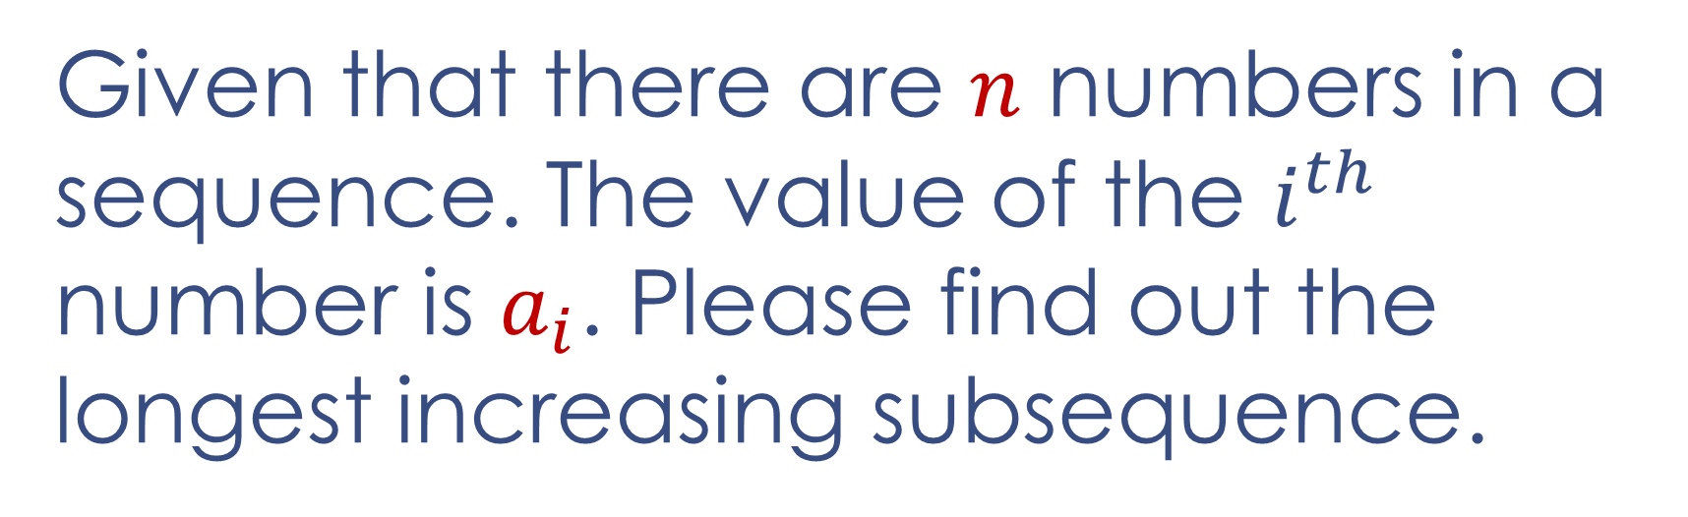
Longest Increasing Subsequence (LIS)
Given that there are $n$ numbers in a sequence. The value of the $i^{th}$ number is $a_{i}$. Please find out the longest increasing subsequence.
e.g. a sequence: 4, 2, 3, 1, 5
Its LIS is 2, 3, 5

Slide 9
North Korea is Launching Missiles
A Dangerous Task for You

Slide 10

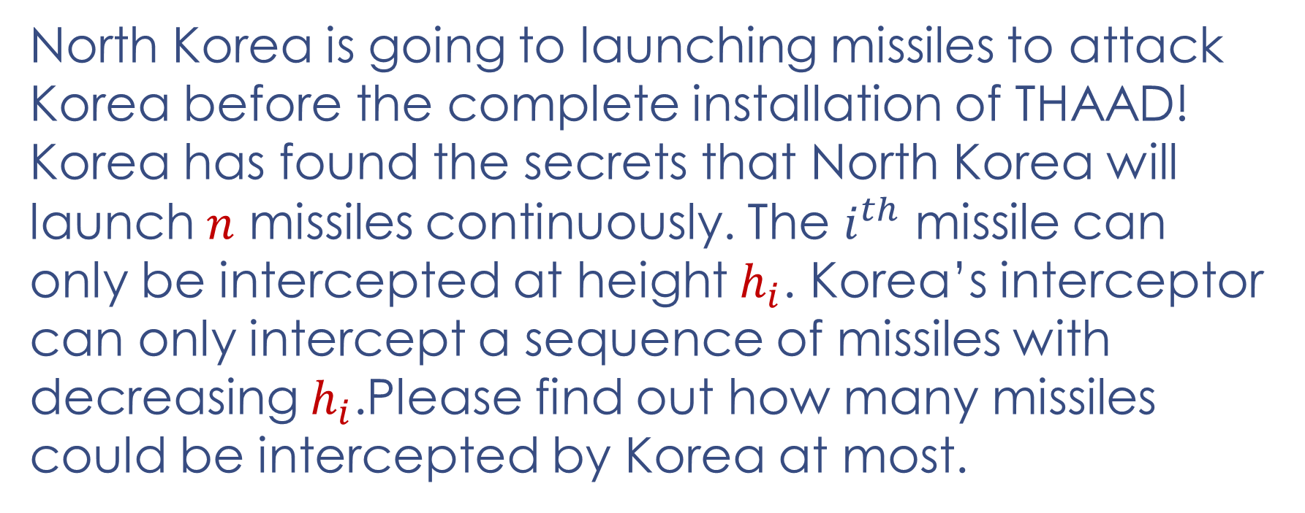
North Korea is Launching Missiles
North Korea is going to launching missiles to attack Korea before the complete installation of THAAD! Korea has found the secrets that North Korea will launch $n$ missiles continuously. The $i^{th}$ missile can only be intercepted at height $h_{i}$. Korea’s interceptor can only intercept a sequence of missiles with decreasing $h_{i}$.Please find out how many missiles could be intercepted by Korea at most.
e.g. $\{h_{i}\}=1000, 5000, 2500, 6000, 500$
Korea will intercept the missiles highlighted above.

Slide 11
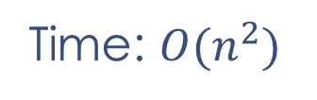


North Korea is Launching Missiles
$$F\left[i\right]=max⁡\{F\left[k\right]+1\}$$
$$k<i, h\left[k\right]>h[i]$$
Time: $O(n^{2})$
1 | 2 | 3 | … | i-1 | i
There is an $O(n\log{n})$ time algorithm which is optimized by binary search and discretization. We will discuss it later.

Slide 12
Let’s Take a Group Photo
A Happy Task for You

Slide 13

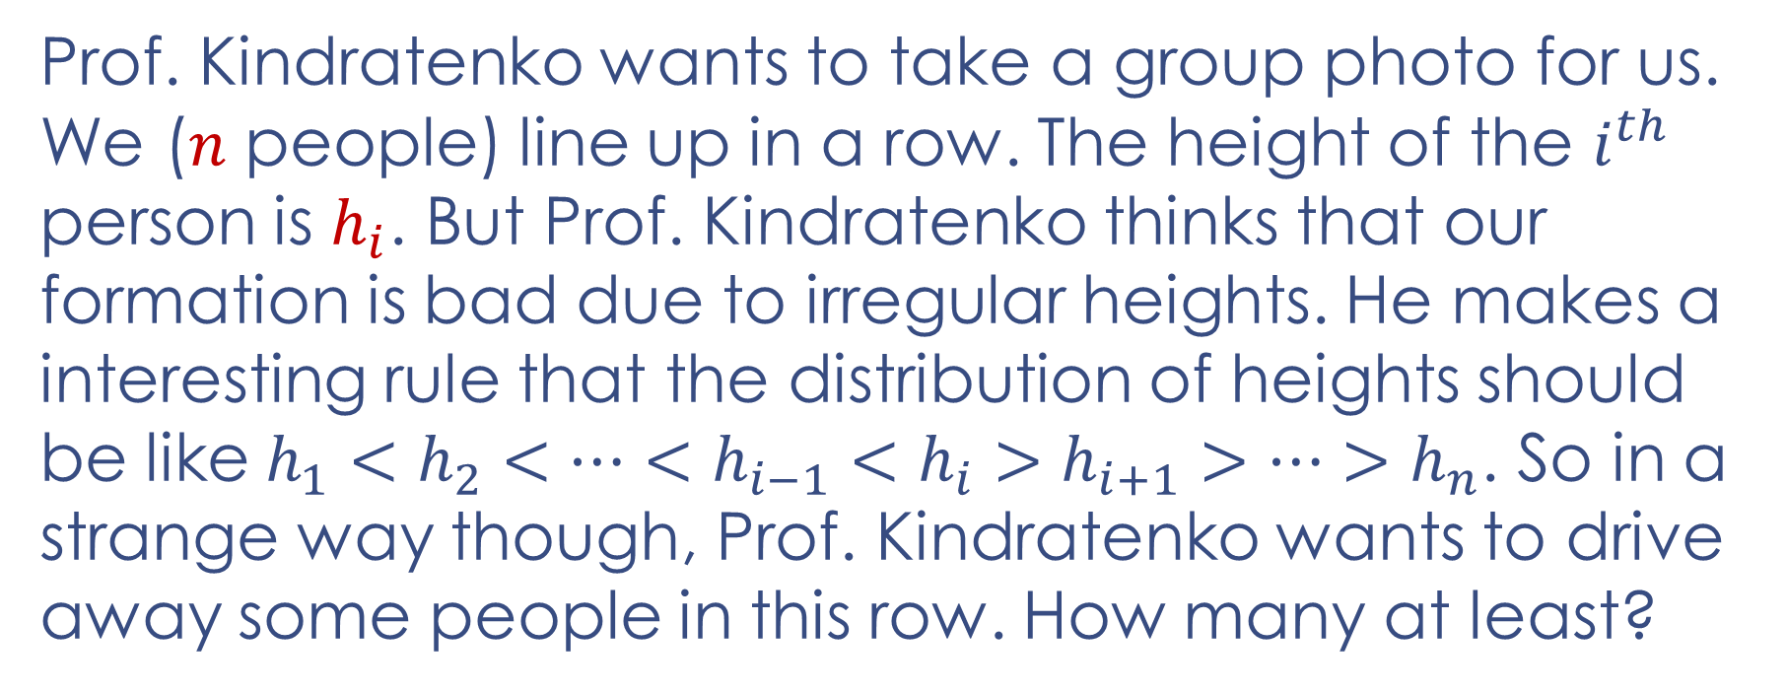
Let’s Take a Group Photo
Prof. Kindratenko wants to take a group photo for us. We ($n$ people) line up in a row. The height of the $i^{th}$ person is $h_{i}$. But Prof. Kindratenko thinks that our formation is bad due to irregular heights. He makes a interesting rule that the distribution of heights should be like $h_{1}<h_{2}<…<h_{i−1}<h_{i}>h_{i+1}>…>h_{n}$. So in a strange way though, Prof. Kindratenko wants to drive away some people in this row. How many at least?
e.g. $\left\{h_{i}\right\}=177, 178, 176, 179, 182, 162, 170, 168$
Professor will drive away people highlighted above.

Slide 14
Take a Break
A Relaxing Task for You

Slide 15
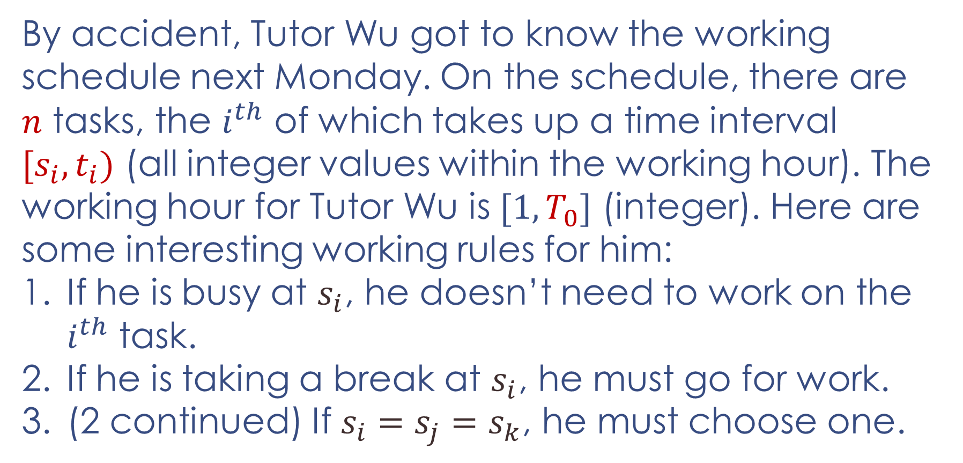
Take a Break
Please help Tutor Wu to work less!
By accident, Tutor Wu got to know the working schedule next Monday. On the schedule, there are $n$ tasks, the $i^{th}$ of which takes up a time interval $[s_{i}, t_{i})$ (all integer values within the working hour). The working hour for Tutor Wu is $[1, T_{0}]$ (integer). Here are some interesting working rules for him:
If he is busy at $s_{i}$, he doesn’t need to work on the $i^{th}$ task.
If he is taking a break at $s_{i}$, he must go for work.
(2 continued) If $s_{i}=s_{j}=s_{k}$, he must choose one.

Slide 16
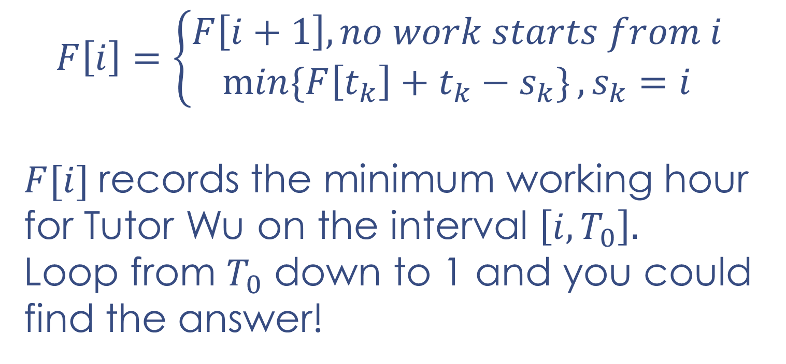
Take a Break
$$F\left[i\right]=\left\{\begin{aligned}F\left[i+1\right], no work starts from i \\ \min{\{F\left[t_{k}\right]+t_{k}−s_{k}\}}, s_{k}=i\end{aligned}\right.$$
$F[i]$records the minimum working hour for Tutor Wu on the interval $\left[i, T_{0}\right].$
Loop from $T_{0}$ down to 1 and you could find the answer!

Slide 17
Thank you!

